Slide 1

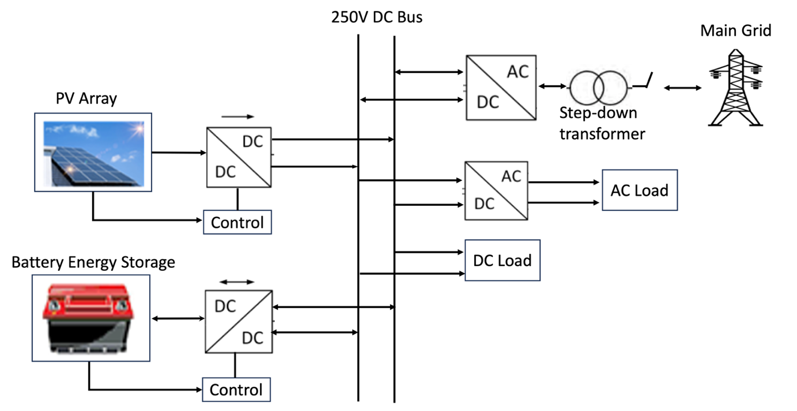
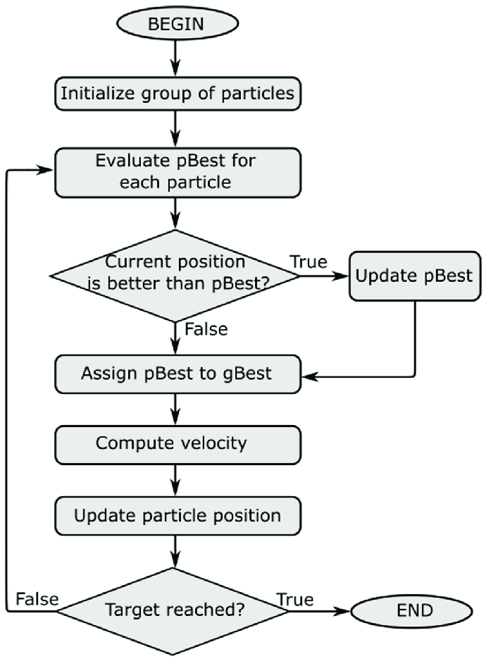
Modelling and Control of a DC Microgrid
Prepared by: Kingsley Macebele
Supervisor: Professor Komla Folly
Introduction
Design and Modelling
Microgrids has evolved to describe interconnected local energy systems operating as single controllable unit that can generate power and provide heat to a community as stated by the Consortium for Electric Reliability Technology Solution (CERTS). They are advanced distribution networks, combining various distributed energy resources (DERs) and loads at the distribution voltage level. This research focuses on DC microgrids, which often faces challenges in maintaining voltage stability, fault protection and power flow between the microgrid and utility grid.
A radial architecture, grid-connected DC microgrid was designed and modelled in MATLAB/Simulink. The model comprises of a PV array, battery storage system and power electronic converters. This architecture was chosen due to simplicity in implementing control schemes and circuit protection.
Figure 1 shows the modelled DC microgrid.
Results
The performance of the DC bus response using the PID controller, PSO as well as fault analysis with and without protection are shown in the results below. A protection relay(PR) was implemented in Simulink, to trip the circuit breaker at t=0.1s when a fault occurs.
Fig 1. DC Microgrid
Control Methods
Discussion
The main priority for control is to ensure voltage stability, system balancing, and power flow management as well as smooth transition from grid-connected mode to islanded mode.
The system utilizes PID controllers for local dc voltage and current control for the 250V dc bus implemented on the bi-directional converter of the battery storage.
The microgrid is optimized using particle swarm optimization (PSO) which is a population-based algorithm introduced by Kennedy and Eberhar in 1995. This is implemented on the boost converter to enable the system to efficiently respond to load changes.
Fig 2 shows PSO algorithm used.
The DC bus was subjected to a constant power load of 10kW and variable loads occurring instantaneously at times: t=0.5s, t=1s, t=3s and t=3.5s. The PID controller was able to maintain voltage stability for O.5 seconds before load disturbance. After 0.5 seconds, an increase in the load demand introduced a poor performance of the DC bus and poor tracking. The PID controller responds well with smaller loads added to the system as seen at t=1s only as depicted in Figure 3-4.
The PSO has a good response to changes in the load demand but with more oscillation at t=0s compared to the PID controller. The 250V dc was able to be maintained for most of the time as seen in Figure 5-7.
A 3-phase fault was introduced at t=0.1s, causing a voltage spike in Figure 8. Through the use of PR, the DC bus voltage goes to zero after t=0.1s but with a delay of 0.07 seconds as seen in Figure 9.
Fig 3. DC bus voltage vs time with PID control
Fig 4. DC bus current vs time with PID control
Fig 5. DC bus voltage vs time with PSO
Fig 6. DC bus current vs time with PSO
Conclusions
Fig 7. DC bus power vs time with PSO
The DC Microgrid was successfully modelled using MATLAB/Simulink and control schemes were implemented to test the performance of the system during different loading conditions. PSO was able to efficiently control the system to response efficiently to load demands. A relay protection method was also implemented which a good response time to faults in the microgrid.
Fig 2. PSO Algorithm
Fig 8. DC bus voltage with 3-phase fault in the grid
Fig 9.DC bus voltage with protection
Contact Information
Kingsley Macebele
University of Cape Town
Email: mcbtin001@myuct.ac.za
Phone: +27 83 657 1220
DEPARTMENT OF ELECTRICAL ENGINEERING

